Slide 1

TENSOR ucb
For INFORMATION RETRIEVAL
and
CONVERSATIONAL AI
Shi Yu
11/24/2020

Slide 2
Problem
Matching Customer Service Query with InfoWave Page
More than 300k customer service queries, most of them should be matched to one or more of 1.6k infowave pages
Questions
3 Rollovers, 1 was Roth but went into a pretax account. How to fix?
Why are three Vanguard funds greyed out for position level dividend update?
Can a client transfer an HSA to an IRA?
Intents
Direct/Indirect Rollover
Dividends/Capital Gains
Incoming Transfer/How-To/Requirements
Infowave Page
http://oedesktop.vanguard.com/us/content/InfoWave/AssocHbk/ProbRes/ProblemResolutionMatrices.js
http://oedesktop.vanguard.com/us/content/InfoWave/OptsManual/SpecOpts/DivCapGainTroubleFAQ.jsp
http://oedesktop.vanguard.com/us/content/InfoWave/IRACompliance/TaxesForms/TaxReliefAct.jsp

Slide 3
CHALLENGES
Infowave page has many variants of representations, which one should we use?
BOW features
Embeddings
Q-A features
Entities
Knowledge
The entire problem space has 300k queries and 1.6k pages. The curated data only has 986 queries and 321 pages.
Using traditional classification method on such a small curated data will be risky
Looking for methods that can adapt and learn
The original project was proposed for conversational AI, therefore users’ feedback will be available

Slide 4
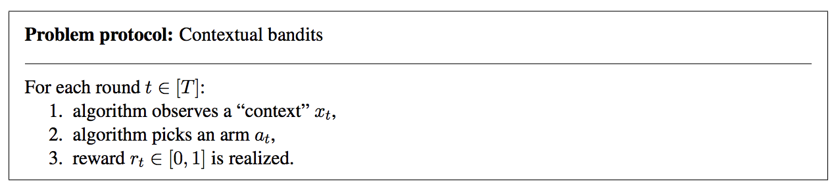
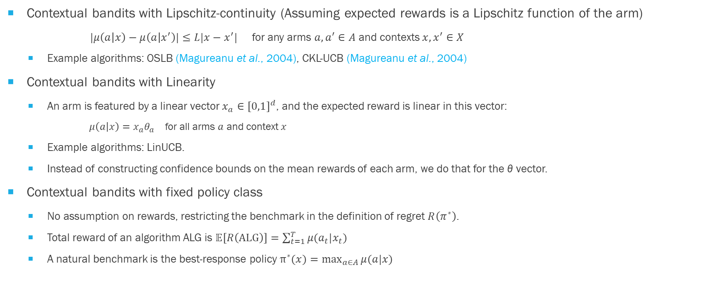
Contextual Bandits in A NUTSHELL
Contextual bandits with Lipschitz-continuity (Assuming expected rewards is a Lipschitz function of the arm)
$|μ\left(a | x\right)−μ\left(a | x^{′}\right)|≤L|x−x^{′}|$ for any arms $a, a^{′}∈A$ and contexts $x, x^{′}∈X$
Example algorithms: OSLB (Magureanu et al., 2004), CKL-UCB (Magureanu et al., 2004)
Contextual bandits with Linearity
An arm is featured by a linear vector $x_{a}∈{[0,1]}^{d}$, and the expected reward is linear in this vector:
$μ\left(a | x\right)=x_{a}θ_{a}$ for all arms $a$ and context $x$
Example algorithms: LinUCB.
Instead of constructing confidence bounds on the mean rewards of each arm, we do that for the θ vector.
Contextual bandits with fixed policy class
No assumption on rewards, restricting the benchmark in the definition of regret $R\left(π^{∗}\right)$.
Total reward of an algorithm ALG is $𝔼[R\left(ALG\right)]=\sum_{t=1}^{T}{μ(a_{t}|x_{t})}$
A natural benchmark is the best-response policy $π^{∗}(x)=\max_{a∈A}{μ(a|x)}$

Slide 5
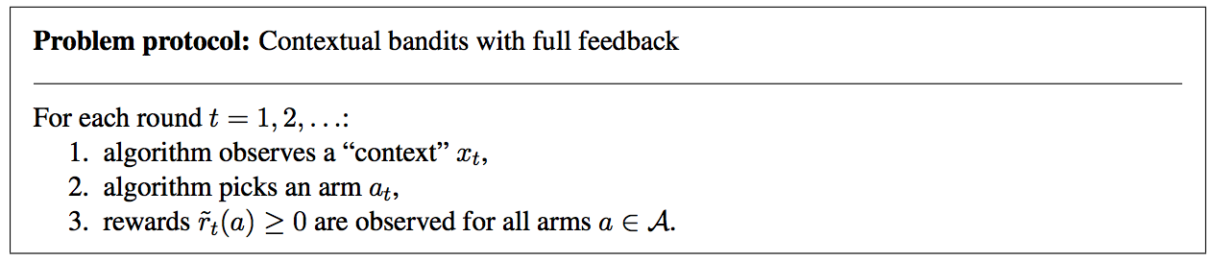
A CLASSIFICATION PROBLEM: FULL-FEEDBACK POLICY
If we have full feedback from OLD data, we can easily learn an optimal policy for OLD data
Classification problem
But in reality, OLD data is very limited, feedback are sparse, NEW data is overwhelming and challenging

Slide 6
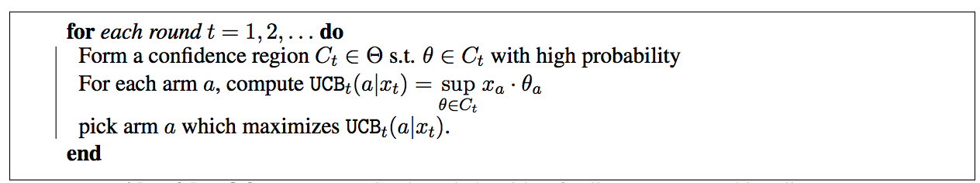

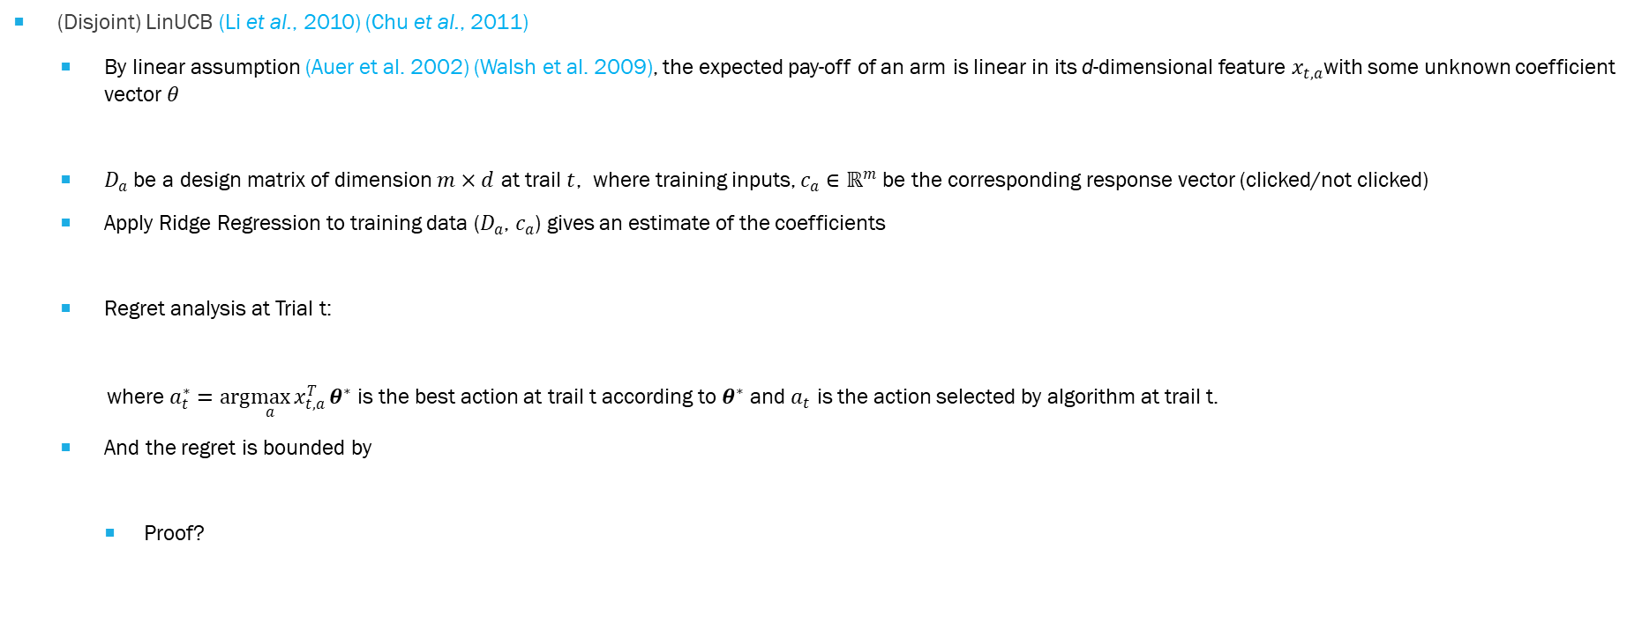

LINEAR CONTEXTUAL BANDIT
(Disjoint) LinUCB (Li et al., 2010) (Chu et al., 2011)
By linear assumption (Auer et al. 2002) (Walsh et al. 2009), the expected pay-off of an arm is linear in its d-dimensional feature $x_{t,a}$with some unknown coefficient vector $θ$
$D_{a}$ be a design matrix of dimension $m×d$ at trail $t$, where training inputs, $c_{a}∈ℝ^{m}$ be the corresponding response vector (clicked/not clicked)
Apply Ridge Regression to training data ($D_{a}$, $c_{a}$) gives an estimate of the coefficients
Regret analysis at Trial t:
where $a_{t}^{∗}=arg\max_{a}{x_{t,a}^{T}}θ^{∗}$ is the best action at trail t according to $θ^{∗}$ and $a_{t}$ is the action selected by algorithm at trail t.
And the regret is bounded by
Proof?
$$𝔼[r_{t,a}|x_{t,a}]=x_{t,a}^{T}θ^{∗}$$
${\hat{θ}}_{a}={\left[D_{a}^{T}D_{a}+λI_{dd} \right]}^{−1}$ $D_{a}^{T}$ $c_{a}$
$\sum_{t=1}^{T}{r_{t,a_{t}^{∗}}−}$ $\sum_{t=1}^{T}{r_{t,a_{t} }}$

Slide 7
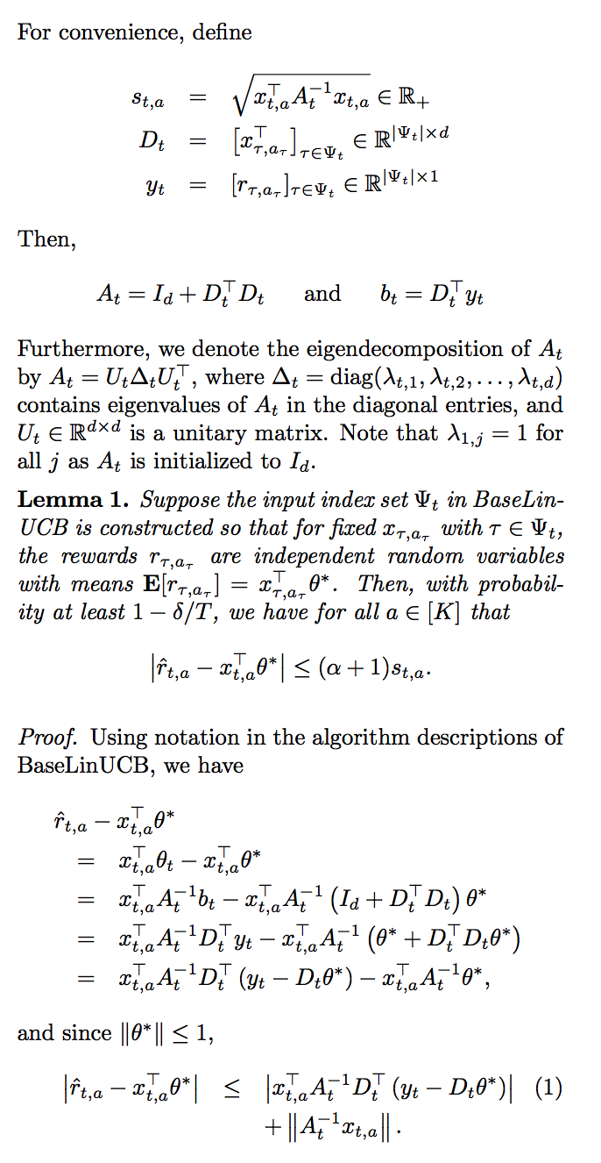
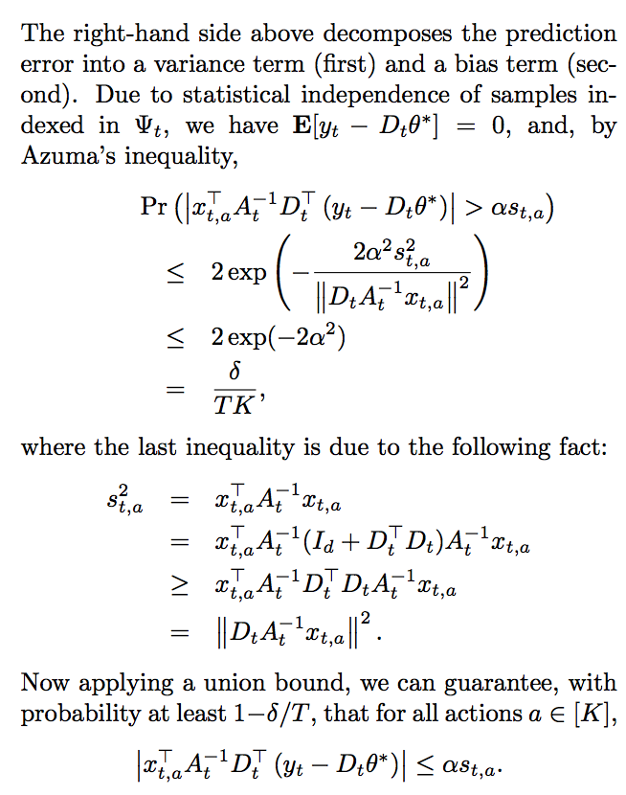
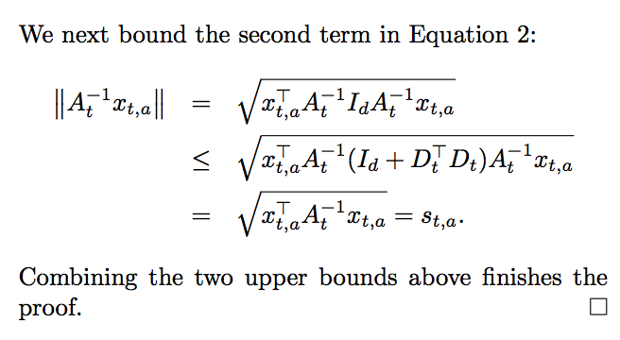
PROOF of LINEAR CONTEXTUAL BANDIT
Chu et al., 2011

Slide 8
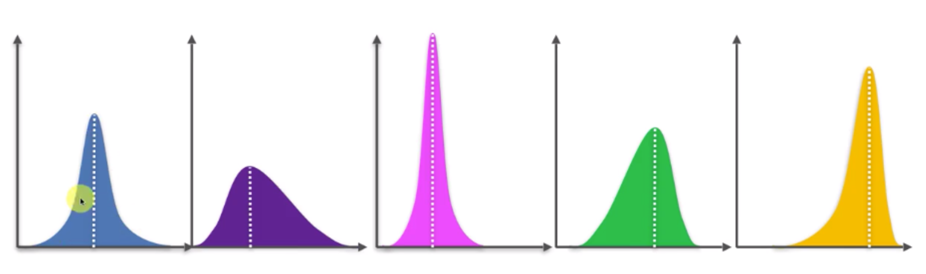
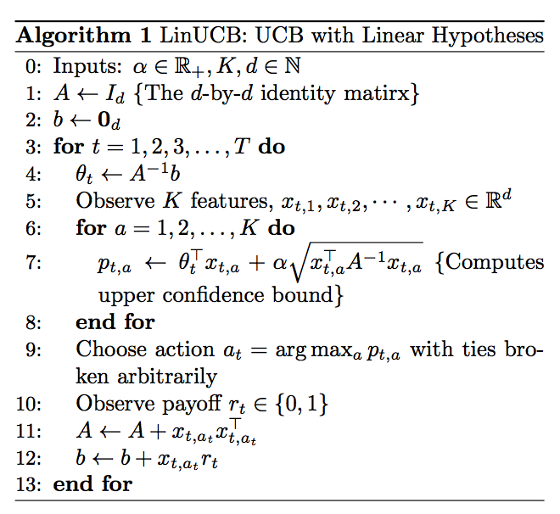
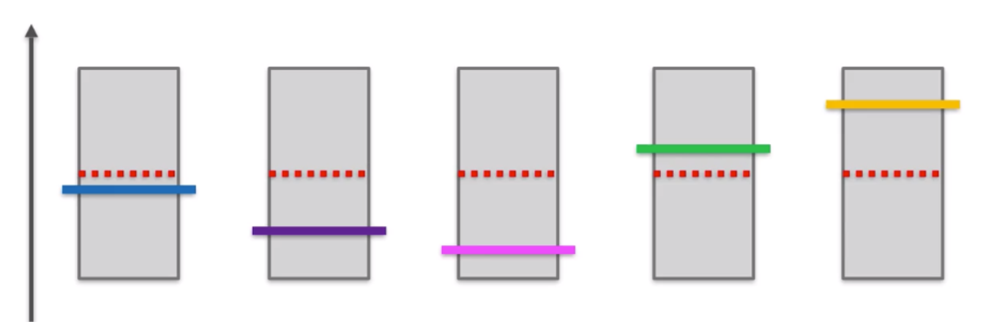
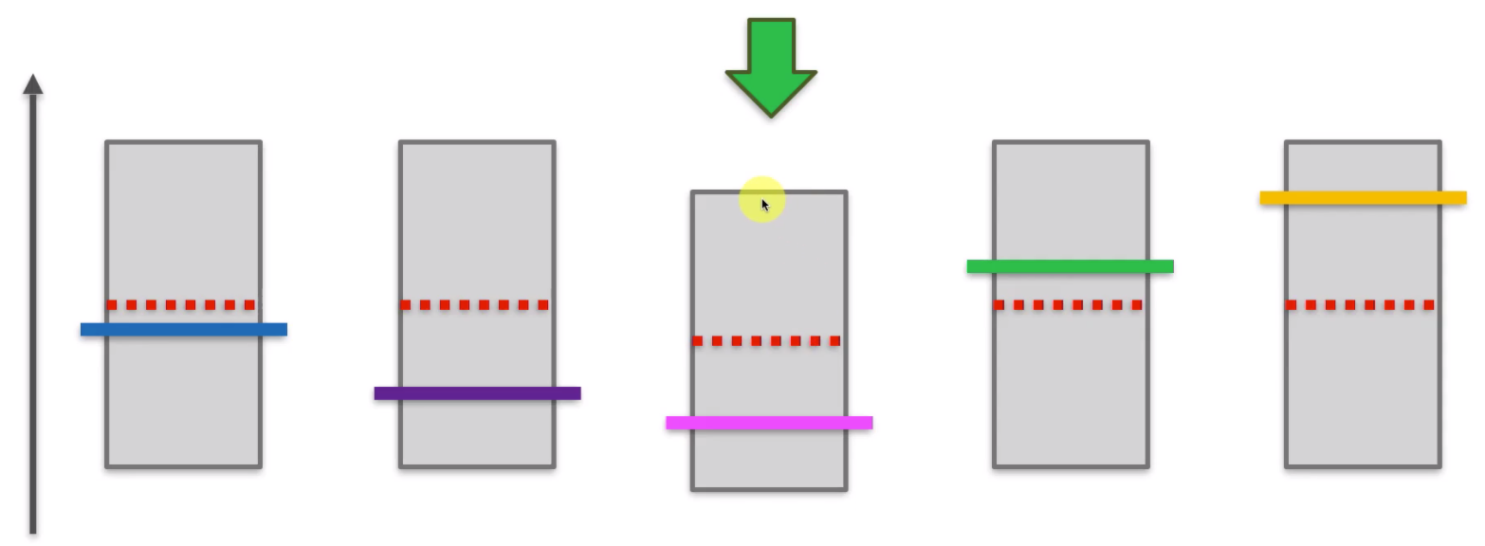
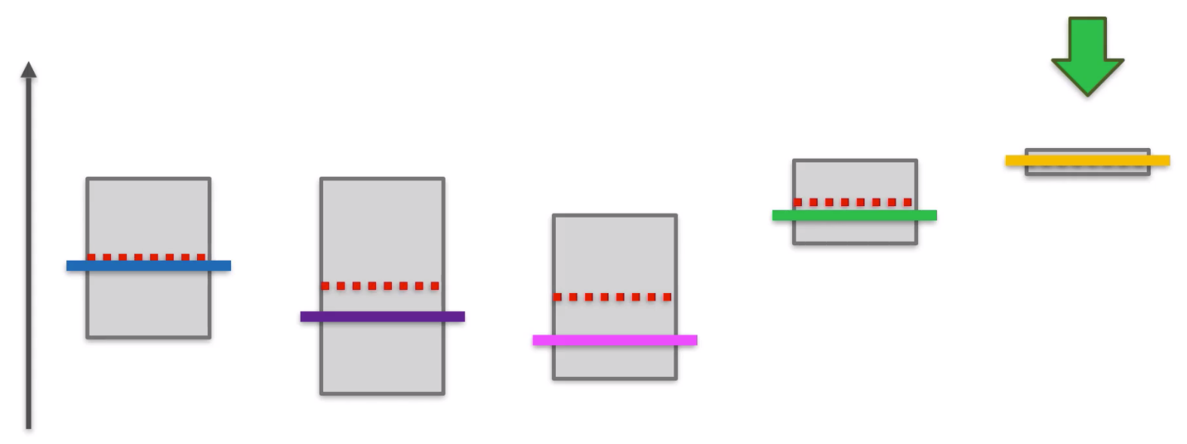
BASE LINUCB Algorithm
Storage of A, b matrices per each arm
Iteration over rounds (usually number of samples)
Iteration over arms (usually number of pages)
Despite its great potentials, LinUCB is notoriously slow on real problems
Need matrix inverse operations T*K times
Storage challenges, though A are generally sparse matrices, A⁻¹ are not sparse

Slide 9
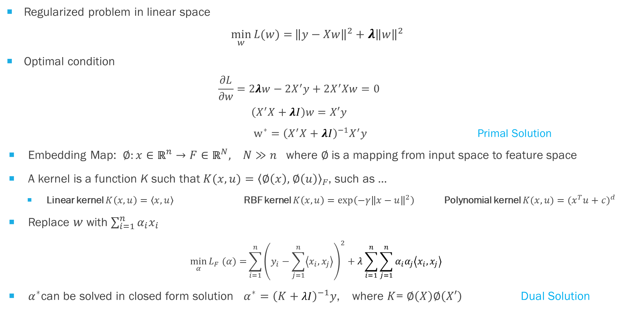
KERNEL RIDGE REGRESSION
Regularized problem in linear space
$$\min_{w}{L(w)=}{\left\|y−Xw\right\|}^{2}+{λ\left\|w\right\|}^{2}$$
Optimal condition
$$\frac{∂L}{∂w}=2λw−2X^{′}y+2X^{′}Xw=0$$
$$\left(X^{′}X+λI\right)w=X′y$$
$w^{∗}=$ ${\left(X^{′}X+λI\right)}^{−1}X^{′}y$ Primal Solution
Embedding Map: $∅:x∈ℝ^{n}→F∈ℝ^{N}, N≫n$ where $∅$is a mapping from input space to feature space
A kernel is a function K such that ${K(x,u)=\left\langle ∅\left(x\right), \right.\left.∅\left(u\right)\right\rangle }_{F}$, such as …
Linear kernel $K\left(x,u\right)=\left\langle x,u\right\rangle$RBF kernel $K\left(x,u\right)=\exp\left(−γ{\left\|x−u\right\|}^{2}\right)$Polynomial kernel $K(x,u)=⁡{(x^{T}u+c)}^{d}$
Replace $w$ with $\sum_{i=1}^{n}{α_{i}x_{i}}$
$$\min_{α}{L_{F} (α)=}\sum_{i=1}^{n}{{\left(y_{i}−\sum_{j=1}^{n}{\left\langle x_{i},x_{j}\right\rangle }\right)}^{2}+λ\sum_{i=1}^{n}{\sum_{j=1}^{n}{α_{i}α_{j}\left\langle x_{i},x_{j}\right\rangle }}}$$
$α^{∗}$can be solved in closed form solution $α^{∗}={\left(K+λI\right)}^{−1}y$, where $K$= $∅\left(X\right)∅\left(X′\right)$ Dual Solution

Slide 10
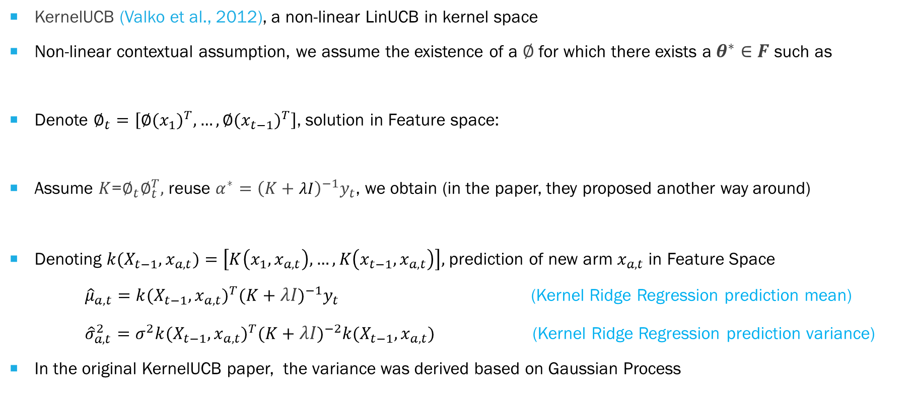
KERNEL UCB
KernelUCB (Valko et al., 2012), a non-linear LinUCB in kernel space
Non-linear contextual assumption, we assume the existence of a $∅$ for which there exists a $θ^{∗}∈F$ such as
Denote $∅_{t}=\left[{∅(x_{1})}^{T},…,{∅(x_{t−1})}^{T}\right]$, solution in Feature space:
Assume $K$=$∅_{t}∅_{t}^{T},$ reuse $α^{∗}={\left(K+λI\right)}^{−1}y_{t}$, we obtain (in the paper, they proposed another way around)
Denoting ${k(X_{t−1}, x}_{a,t})=\left[K\left(x_{1},x_{a,t}\right),…,K\left(x_{t−1},x_{a,t}\right)\right],$prediction of new arm $x_{a,t}$in Feature Space
${\hat{μ}}_{a,t}={{k(X_{t−1}, x}_{a,t})}^{T}{(K+λI)}^{−1}y_{t}$ (Kernel Ridge Regression prediction mean)
${\hat{σ}}_{a,t}^{2}=σ^{2}{{k(X_{t−1}, x}_{a,t})}^{T}{(K+λI)}^{−2}{{k(X_{t−1}, x}_{a,t})}^{}$ (Kernel Ridge Regression prediction variance)
In the original KernelUCB paper, the variance was derived based on Gaussian Process
$$𝔼[r_{t,a}|x_{t,a}]=∅{(x_{t,a})}^{T}θ^{∗}$$
${θ_{t}=(∅_{t}^{T}∅_{t}+λI)}^{−1}$ $∅_{t}^{T}y_{t}$
$$θ_{t}{=∅}_{t}^{T}α_{t}$$
$${\hat{μ}}_{a,t}={{k(X_{t−1}, x}_{a,t})}^{T}{(K+σ^{2}I)}^{−1}y_{t}$$
(Kernel Gaussian Process prediction mean)
${\hat{σ}}_{a,t}=$ ${k(x_{a,t}, x}_{a,t})−{{k(X_{t−1}, x}_{a,t})}^{T}{(K+σ^{2}I)}^{−1}$ ${k(X_{t−1}, x}_{a,t})$
(Kernel Gaussian Process prediction variance)

Slide 11
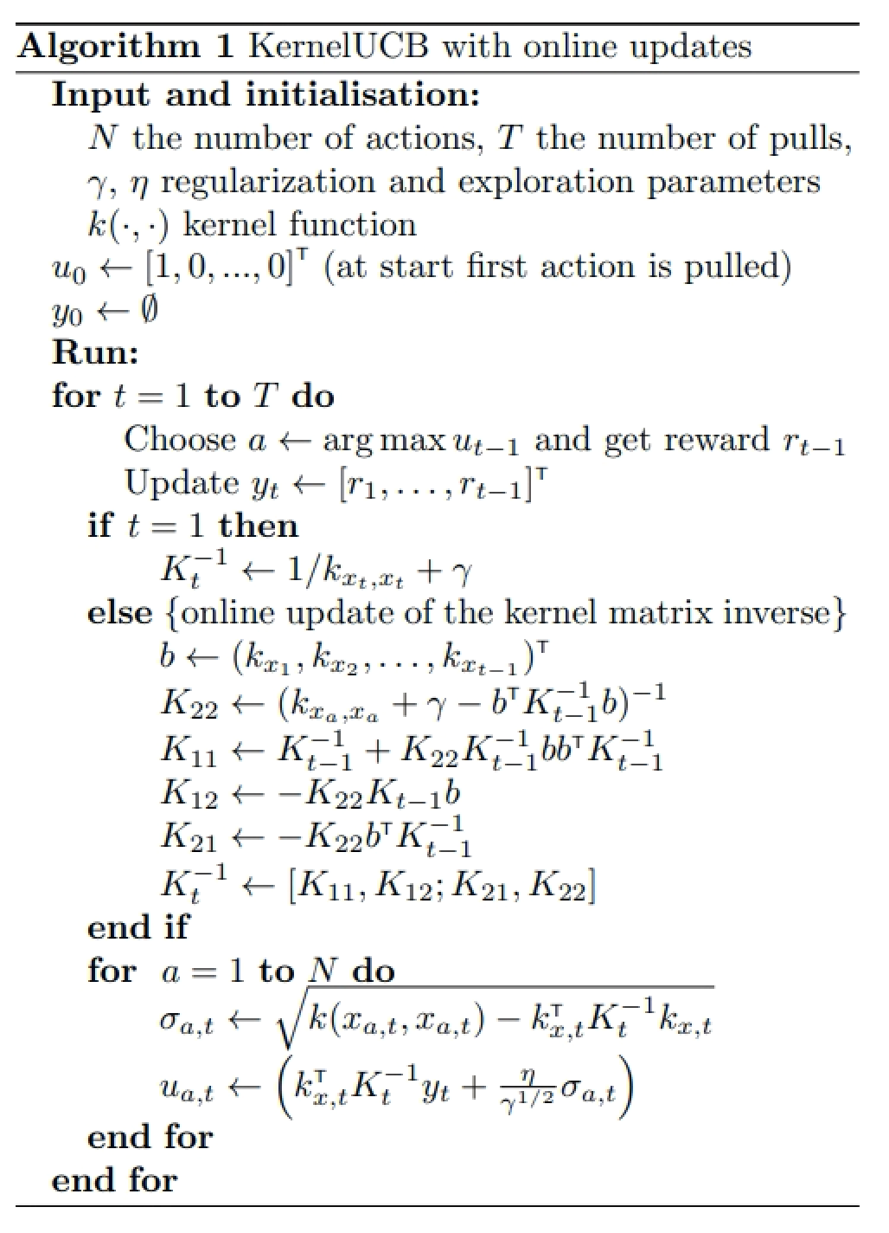
KERNEL UCB Algorithm
Iteration over rounds
Need to store/compute the kernel matrix of
all (unique) arms that have been pulled
For 986x321 problem, it is a matrix of 316K * 316K
Storing that matrix requires about 746G memory
Iteration over arms

Slide 12
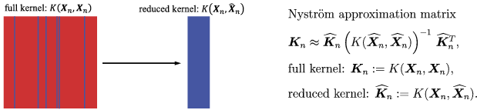




NystrÖM KERNEL RIDGE REGRESSION
Nystrom method (Williams & Seeger, 2001)
Approximated Feature Map (Vedaldi and Zisserman, 2011)
Given a positive-definite kernel $K\left(x,y\right)$ and a data density $p\left(x\right)$, the Nyström approximation of order M is the feature map $φ:ℝ^{N}$→ $ℝ^{M}$
Reconsider Ridge Regression and Kernel Ridge Regression (Primal form)
Kernel trick
Approximation (eigendecomposition)
$$X$$
$$K=∅(X)∅({X)}^{T}$$
$$Z$$
$w={X^{T}\left[X^{T}X+λI\right]}^{−1}$ $y$
$$w={∅(X)}^{T}{\left[∅(X)∅({X)}^{T}+λI\right]}^{−1}y$$
$$w=Z^{T}{\left[Z^{T}Z+λI\right]}^{−1}y$$
$\hat{y}=x^{T}w=x^{T}X^{T}{\left[X^{T}X+λI\right]}^{−1}$ $X^{T}y$
$$\hat{y}={∅(x)}^{T}w={∅(x)}^{T}∅({X)}^{T}{\left[∅(X)∅({X)}^{T}+λI\right]}^{−1}y$$
$$\hat{y}=z^{T}Z^{T}{\left[Z^{T}Z+λI\right]}^{−1}y$$

Slide 13
NystrÖM KERNEL RIDGE REGRESSION
Query-Infowave page problem
Query features 500-dimension TFIDF scores
Page features 500-dimension TFIDF scores from Title, Text, Keywords, Description of the page
Raw Arm features are concatenated features (1000 TFIDF) from 986 queries, 321 pages
Using raw features directly
 | Train AUC | Test AUC
Text | 0.784 | 0.364
Title | 0.779 | 0.379
Keywords | 0.783 | 0.36
Description | 0.784 | 0.364

Slide 14
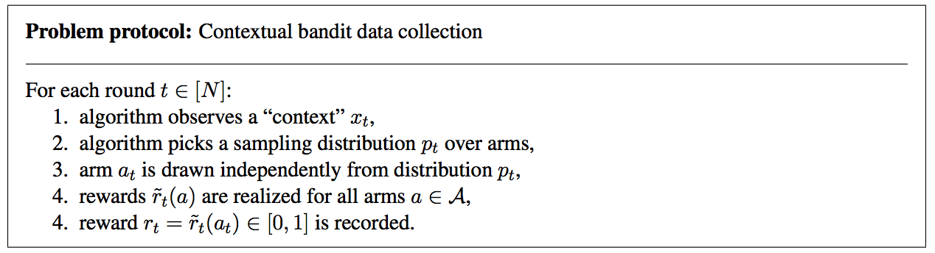
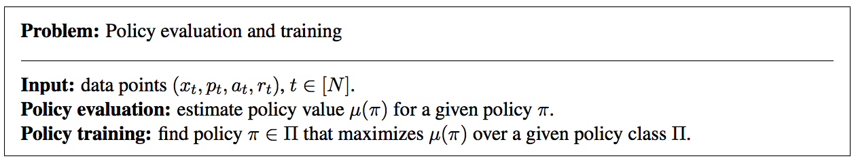
Learning from CONTEXTUAL BANDIT DATA
Query-Infowave page problem
Query features 500-dimension TFIDF scores
Page features 500-dimension TFIDF scores from Title, Text, Keywords, Description of the page
Raw Arm features are concatenated features (1000 TFIDF) from 986 queries, 321 pages

Slide 15
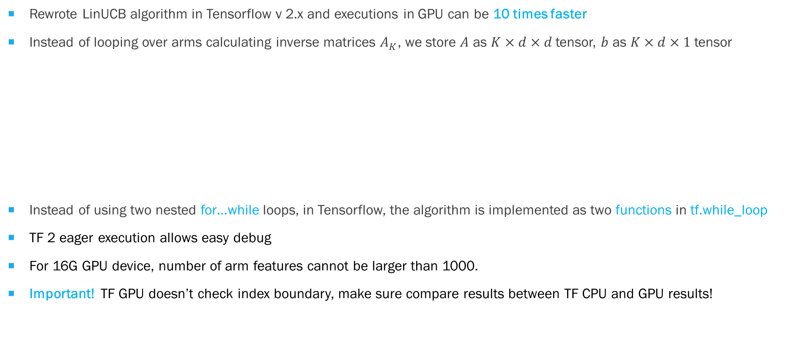
TENSOR UCB v1: LinUCB in TENSORFLOW
Rewrote LinUCB algorithm in Tensorflow v 2.x and executions in GPU can be 10 times faster
Instead of looping over arms calculating inverse matrices $A_{K}$, we store $A$ as $K×d×d$tensor, $b$ as $K×d×1$tensor
Instead of using two nested for…while loops, in Tensorflow, the algorithm is implemented as two functions in tf.while_loop
TF 2 eager execution allows easy debug
For 16G GPU device, number of arm features cannot be larger than 1000.
Important! TF GPU doesn’t check index boundary, make sure compare results between TF CPU and GPU results!
N_arm features
N_arm features
N_arm features
A
1
b
tf.linalg.solve
N_arms

Slide 16

TENSOR UCB v2: NYSTROM features in LinUCB
Enumerate all combinations of queries (400) and pages (161)
Original arm features $X_{a_{ij} }=np.concat({query}_{i},{page}_{j})$ 64,400 x 1,000
Apply Linear/RBF Kernel on $X_{a_{ij} }$ $K=∅(X_{a_{ij}})$ $∅(X_{a_{ij}}^{T})$
Apply Nyström on $K$ and reduce 500 components as new arm features
Arm features created from Page Text perform the best, Raw features perform better than Nyström features

Slide 17

TENSOR UCB v3: MULTISOURCEs in LinUCB
Further extend UCB to incorporate multiple arm features derived from multiple sources
Assume that expected pay-off of multiple arms is the maximum among its linear correlations with some unknown coefficient vector $θ_{S}$ in each source
According to prediction means and variances in multiple sources, select the arm with largest variance
N_arm features
N_arm features
A2
A3
A4
A1
N_arms
Query + Page
Text Features
Query + Page
Title Features
Query + Page
Keywords Features
Query + Page
Description Features
$$𝔼\left[r_{t,a} | x_{t,a}\right]=\max_{S}{x_{t,a}^{T}θ_{S}^{∗}}$$
$$w_{S}={Z_{S}\left[Z_{S}^{T}Z_{S}+λI\right]}^{−1}y$$
$${\hat{y}}_{S}=z_{S}^{T}{Z_{S}\left[Z_{S}^{T}Z_{S}+λI\right]}^{−1}y$$

Slide 18
TENSOR UCB v3 RESULTS
Vanguard data: 400 queries, 161 Infowave pages. All arm features are created by Nyström on RBF kernels constructed from feedback data, and reduced to 500, 1000, 2500 pcs
Four difference sources (arm features) are combined:
500d TFIDF Query + 500d TFIDF Page Text
500d TFIDF Query + 500d TFIDF Page Title
500d TFIDF Query + 500d TFIDF Page Keywords
500d TFIDF Query + 500d TFIDF Page Description

Slide 19
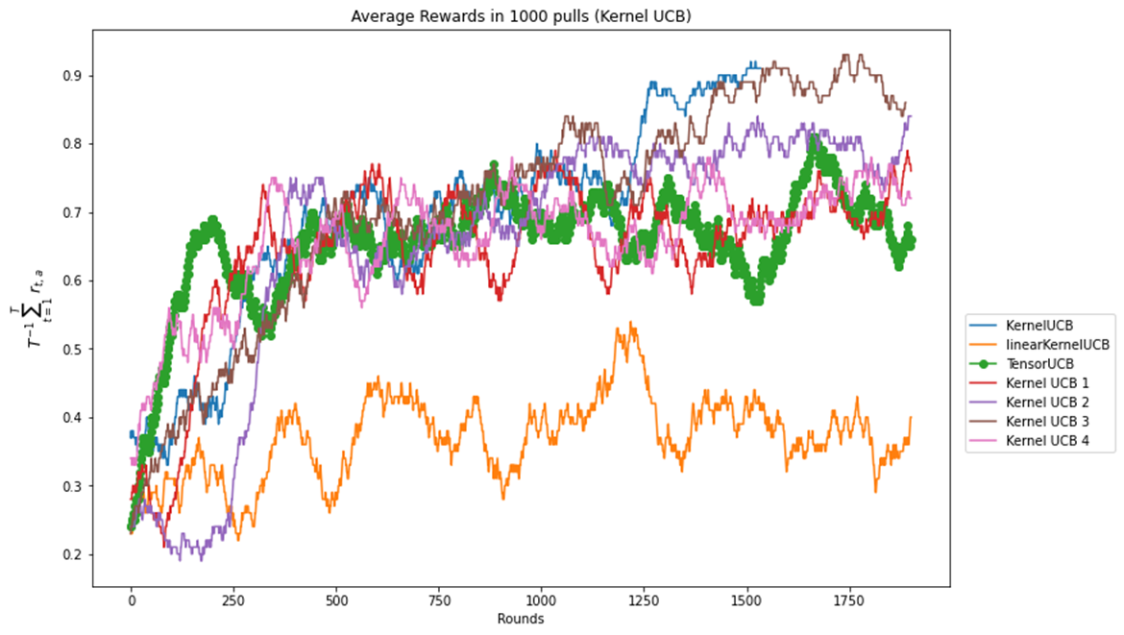
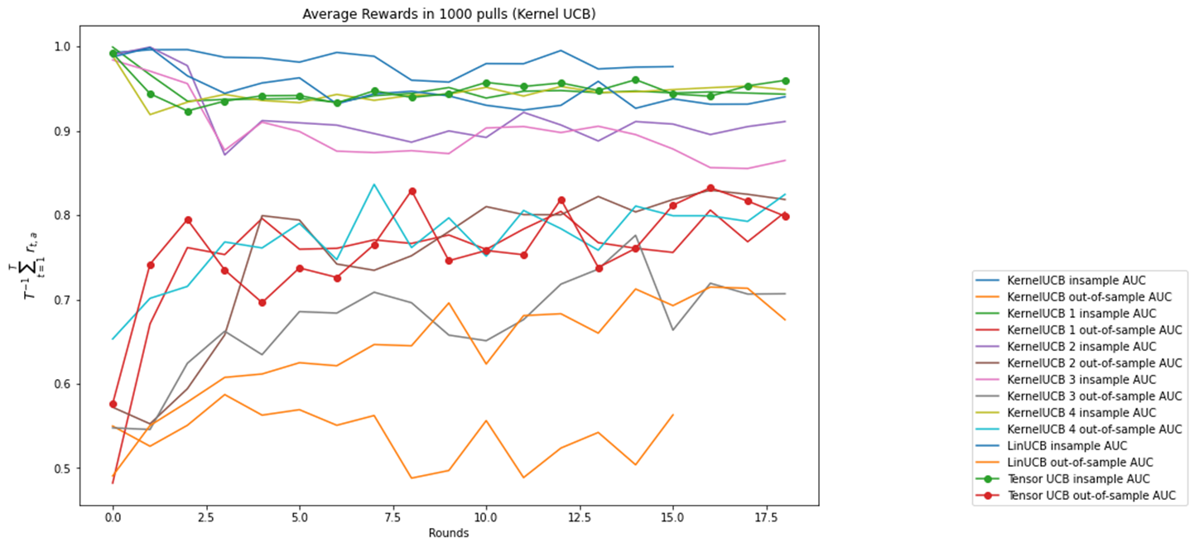
TENSOR UCB v3 RESULTS
Public data: on another (unknown, probably MovieLens) data set, arm features are 10-dimensional, 10 candidate arms, 10k samples
TensorUCB is used to combine RBF kernels on same sampled data using different kernel widths (gamma)

Slide 20

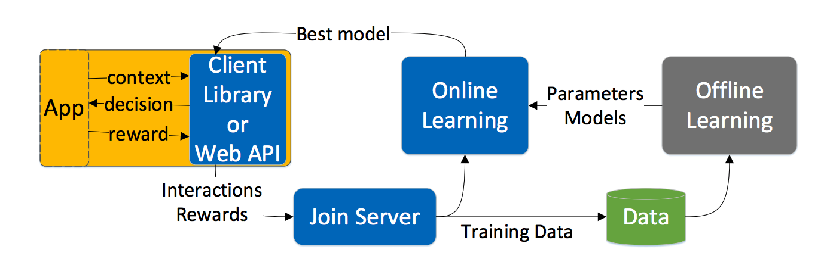
CONTEXTUAL BANDITS: CHALLENGEs and SYSTEM DESIGN
Front-end system: directly interacts with users, extremely fast
Chatbot with feedback collections
Compute actions given the context
Online update
Back-end system: powerful data processing at slower time scales
Full feedback update
Policy evaluation and learning
Policy Execution
Exploration
Logging
Learning
Policy Deployment

Slide 21
CONCLUSIONS
Proposed a complete solution using Contextual MAB to match queries with webpages.
Using MAB to solve information retrieval problems is novel
Implemented LinUCB algorithm in Tensorflow and now runs 10 – 50 times faster than CPU version
Training 400 epoch on 400x161 matching problem (arm feature 500) takes about 45k seconds
Potential improvement towards sparse solution in Tensorflow, or Multiple GPU versions
Compared KernelUCB with LinUCB, and proposed Nyström feature mapping for KernelUCB
Allows fixed-size kernels to fit the size of GPU memory
Reuse Tensorflow implementation of LinUCB to solve KernelUCB problem
Invent TensorUCB by extending LinUCB, KernelUCB, NyströmUCB to multiple sources
Pay-off is a nonlinear (maximum) combination of multiple linear contextual bandits, each construct for a specific source (feature set)
Using normalized LinearKernel, or RBFKernel, the uncertainty of Kernel Ridge Regression is bounded, that allows a fair comparison of the upper confidence bound (UCB)

Slide 22
REFERENCES
Magureanu et al., 2004: Lipschitz Bandits: Regret Lower Bounds and Optimal Algorithms, JMLR: Workshop and Conference Proceedings vol 35:1–25, 2014
Li et al., 2010: A Contextual-Bandit Approach to Personalized News Article Recommendation, WWW 2010
Chu et al., 2011: Contextual Bandits with Linear Payoff Functions, Volume 15 of JMLR: W&CP 15, 2011
Williams & Seeger, 2001: Using the Nystroem method to speed up kernel machines, Advances in neural information processing systems 2001
Vedaldi and Zisserman, 2011: Efficient Additive Kernels via Explicit Feature Maps, IEEE Transactions on Software Engineering 34(3):480-92
Slivkins 2019: Introduction to Multi-Armed Bandits, fullbook, https://arxiv.org/abs/1904.07272
Zhou 2016: A Survey on Contextual Multi-armed Bandits, https://arxiv.org/pdf/1508.03326.pdf

